Slide 1

DATABASE SYSTEMS (EIE36E): Working with multiple tables
Doc. Ing. Václav Vostrovský Ph.D.
Ing. Petr Hanzlík

Slide 2

Outline > Working with multiple tables
repeating what we know
SELECT from two tables
INNER JOIN
LEFT JOIN
RIGHT JOIN
FULL JOIN

Slide 3
SQL DML: SELECT
SELECT from multiple tables is based on pairing the primary and foreign key
SQL SELECT syntax:
SELECT <column1,..,columnn>
FROM table1, table2
WHERE table1.key=table2.key
;

Slide 4
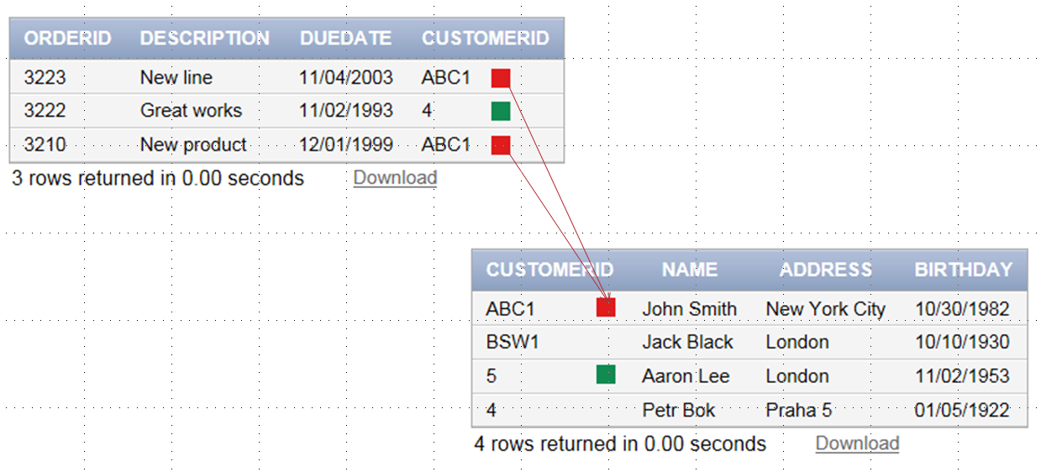
SQL DML: SELECT

Slide 5
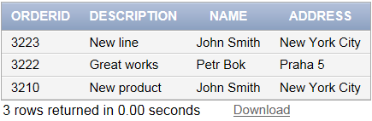
SQL DML: SELECT example
Select orderID, Description, Customer name and address :
SELECT orderid,description,customer.name,customer.address
FROM order,customer
WHERE customer.customerid = order.customerid
;

Slide 6
SQL DML: JOIN
JOIN is used to combine tuples from two or more tables, based on a common link between them.
Defined in several varieties:
INNER JOIN
LEFT JOIN
RIGHT JOIN
FULL JOIN

Slide 7
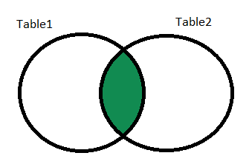
SQL DML: INNER JOIN
INNER JOIN returns all rows from multiple tables where the join condition is met. Only the coupled output is returned.
SQL INNER JOIN syntax:
SELECT table1.column1,…,table2.columnN
FROM table1 INNER JOIN table2
ON table1.FKEY=table2.PKEY
;

Slide 8
SQL DML: INNER JOIN
Select orders with matching customers. Select orderID, description, and client name and address
SELECT order.orderid,order.description, customer.name,customer.address
FROM order INNER JOIN customer
ON customer.customerid = order.customerid
;

Slide 9
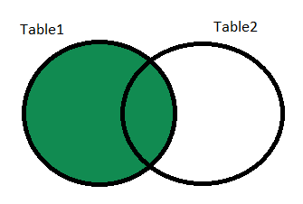
SQL DML: LEFT JOIN
LEFT JOIN return all rows from the left table, and the matched rows from the right table
SQL LEFT JOIN syntax:
SELECT table1.column1,…,table2.columnN
FROM table1 LEFT JOIN table2
ON table1.FKEY=table2.PKEY
;

Slide 10
SQL DML: LEFT JOIN
Select all the orders with matching customers. orderID, description, and client name, address only
SELECT order.orderid,order.description, customer.name,customer.address
FROM order INNER JOIN customer
ON customer.customerid = order.customerid
;
Notes:
All the orders are selected and paired with referenced customers

Slide 11
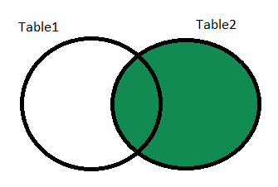
SQL DML: RIGHT JOIN
RIGHT JOIN return all rows from the right table, and the matched rows from the left table
SQL RIGHT JOIN syntax:
SELECT table1.column1,…,table2.columnN
FROM table1 RIGHT JOIN table2
ON table1.FKEY=table2.PKEY
;

Slide 12
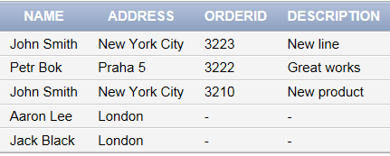
SQL DML: RIGHT JOIN
Select all the customers with their orders, important attributes only.
SELECT ordering.orderid,ordering.description, customer.name,customer.address
FROM ordering RIGHT JOIN customer
ON customer.customerid = ordering.customerid
;

Slide 13
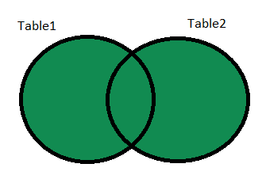
SQL DML: FULL JOIN
FULL JOIN combines left and right joins together. Return all rows when there is a match in ONE of the tables
SQL FULL JOIN syntax:
SELECT table1.column1,…,table2.columnN
FROM table1 FULL JOIN table2
ON table1.FKEY=table2.PKEY
;

Slide 14
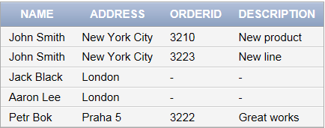
SQL DML: FULL JOIN
List all the entities from both tables, pair matching ones.
SELECT ordering.orderid,ordering.description, customer.name,customer.address
FROM ordering FULL JOIN customer
ON customer.customerid = ordering.customerid
;

